Slide 1
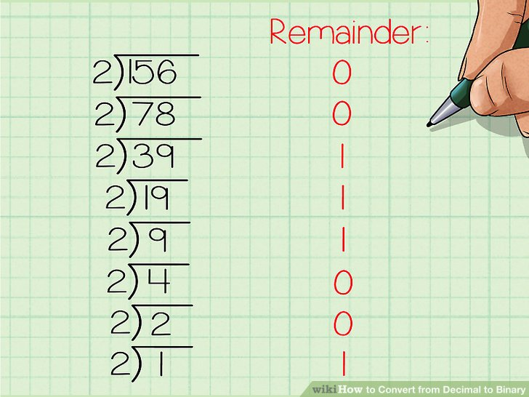
Number Systems And Conversions With Programs
We can represent numbers in following notations.
1.Binary. ( n base 2)
2.Octal. (n base 8)
3.Decimal.(n base 10)
4.Hexadecimal.(n base 16) here n = any number
1.Decimal to Binary Conversion:
Here for converting Decimal to Binary the manual method is to go on divide the given number by 2 .
The remainder will the Binary value of the given Decimal number.

Slide 2
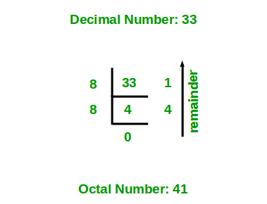
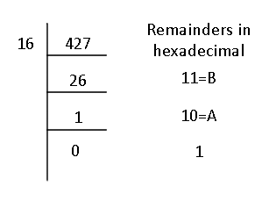
2.Decimal to Octal Conversion:
Here for converting Decimal to Octal the manual method is to go on divide the given number by 8 .
The remainder will the Octal value of the given Decimal number.
3.Decimal to Hex-Decimal Conversion:
Here for converting Decimal to Hex the manual method is to go on divide the given number by 16 .
The remainder will the Hex value of the given Decimal number.

Slide 3
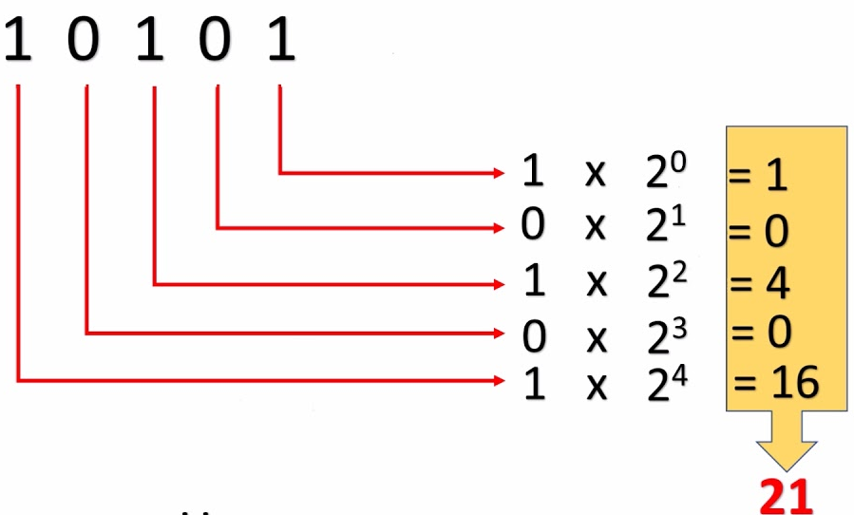
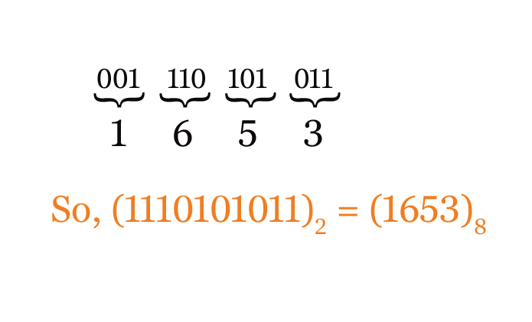
4. Binary to Decimal Conversion:
Here for converting Binary to Decimal the manual method is to go on powering(0 to n) the given Binary value by 2 .
At last to find Decimal value add the all powered value to obtain the Decimal number.
5. Binary to Octal Conversion:
Here for converting Binary to Octal the manual method is make a group of 3 digits of given Binary value.
And then repeat the first step of the Binary to Decimal Conversion. But do not add the all powered values keep it as it is.

Slide 4
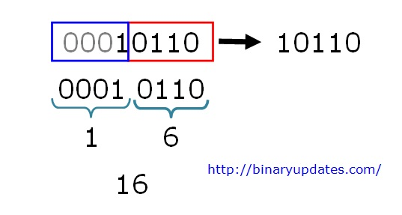
6. Binary to Hex Conversion:
Here for converting Binary to Octal the manual method is make a group of 4 digits of given Binary value.
And then repeat the same step of the Binary to Octal Conversion.

Slide 5
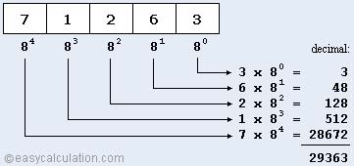
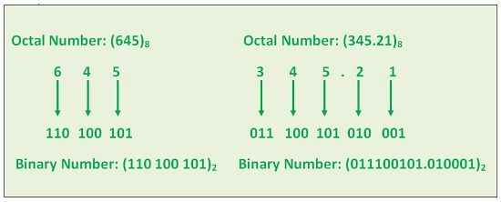
7.Octal to Decimal Conversion:
Here for converting Octal to Decimal the manual method is to go on powering(0 to n) the given Octal value by 8 .
At last to find Decimal value add the all powered value to obtain the Decimal number.
8.Octal to Binary Conversion:
Here for converting Octal to Binary the manual method is separate the given number into one one digit and find the Binary of each digit .
At last to write all Binary value serially to obtain the Binary number.

Slide 6
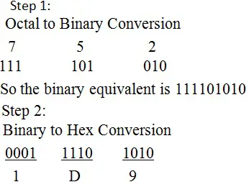
9.Octal to Hex-Decimal Conversion:
Here for converting Octal to Binary the manual method is first convert given number to Binary.
Then further convert that to Hex Decimal.

Slide 7
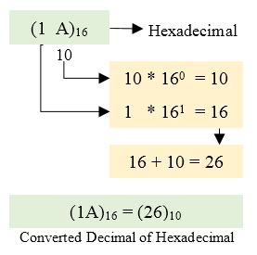
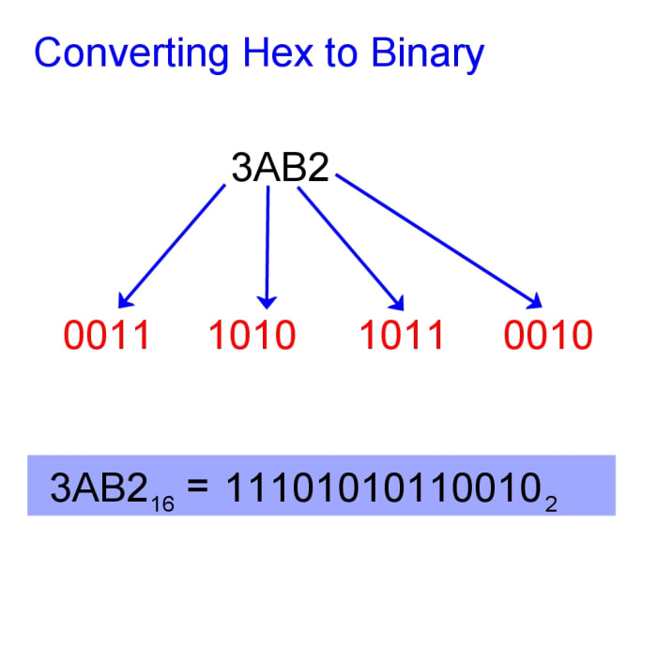
10.Hex-Decimal to Decimal Conversion:
Here for converting Hex to Decimal the manual method is to go on powering(0 to n) the given Binary value by 16.
At last to find Decimal value add the all powered value to obtain the Decimal number.
11.Hex-Decimal to Binary Conversion:
Here for converting Hex to Binary the manual method is separate the given number into one one digit and find the Binary of each digit .
At last to write all Binary value serially to obtain the Binary number.

Slide 8
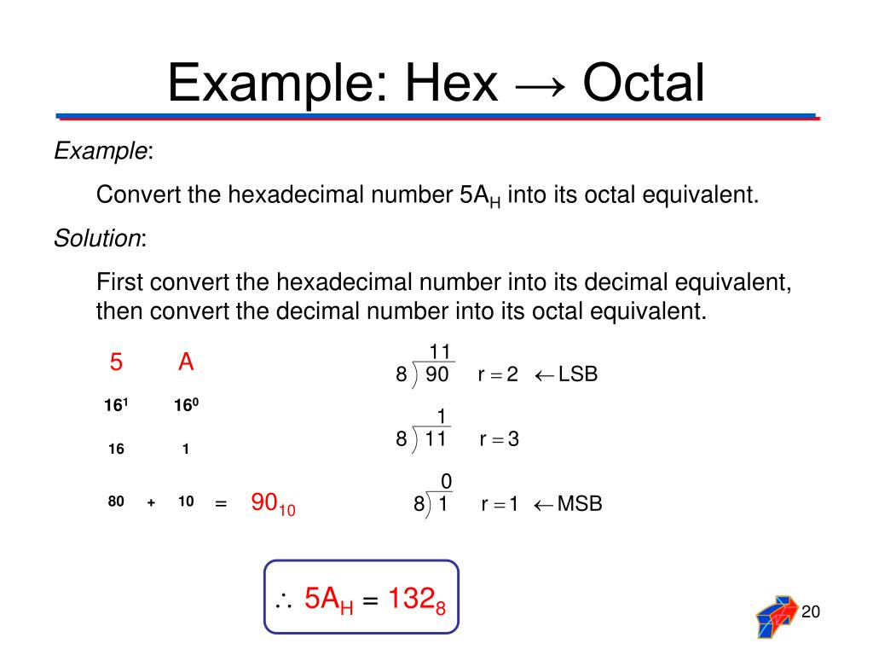
12.Hex-Decimal to Octal Conversion:
Here for converting Hex to Octal the manual method is first convert given number to Decimal.
Then further convert that to Octal.

Slide 9
Programs On Number System:
1.Converting Decimal To Binary:
#include <stdio.h>
void decToBinary(int n)
{
int binaryNum[32]; // array to store binary number
int i = 0; // counter for binary array
while (n > 0)
{
binaryNum[i] = n % 2; // storing remainder in binary array
n = n / 2;
i++;
}
for (int j = i - 1; j >= 0; j--) // printing binary array in reverse order
printf("%d", binaryNum[j]);
}
int main() // Driver program to test above function
{
int n ;
printf("Enter the decimal number:");
scanf("%d",&n);
decToBinary(n);
return 0;
}
Output:
Enter the decimal number:18
Binary value: 10010

Slide 10
2.Converting Octal to Decimal:
#include <stdio.h>
#include <math.h>
int OctalToDecimal(int num)
{
int x = 0;
int ans = 0;
while (num > 0)
{
int y = num % 10; // obtaining the right-most digit of num
num /= 10; // Since the right-most digits were previously scanned in the previous step, divide num by 10 to remove them.
ans += y * pow(8, x);
++x;
}
return ans;
}
int main()
{
int num;
printf("Enter Octal Number: ");
scanf("%d", &num);
printf("\n");
printf("Decimal Number is : %d", OctalToDecimal(num));
return 0;
}
Output:
Enter Octal Number: 32
Decimal Number is : 26

Slide 11
3.Converting Hex-decimal to Decimal:
#include <stdio.h>
#include <math.h>
#include <string.h>
#define ARRAY_SIZE 20
int main()
{
char hex[ARRAY_SIZE];
long long decimal = 0, base = 1;
int i = 0, value, length;
/* Get hexadecimal value from user */
printf("Enter hexadecimal number: ");
fflush(stdin);
fgets(hex,ARRAY_SIZE,stdin);
length = strlen(hex);
for(i = length--; i >= 0; i--)
{
if(hex[i] >= '0' && hex[i] <= '9')
{
decimal += (hex[i] - 48) * base;
base *= 16;
}
else if(hex[i] >= 'A' && hex[i] <= 'F')
{
decimal += (hex[i] - 55) * base;
base *= 16;
}
else if(hex[i] >= 'a' && hex[i] <= 'f')
{
decimal += (hex[i] - 87) * base;
base *= 16;
}
}
printf("\nHexadecimal number = %s", hex);
printf("Decimal number = %lld\n", decimal);
return 0;
}
Output:
Enter hexadecimal number: a
Hexadecimal number = a
Decimal number = 10

